Slide 1
NODE JS TRAINING #marin_ninjas
Marin Vasilev
Toshko Popov
Milan Zarkov
Guldjan Kupen

Slide 2
Agenda
The product
Each team member
Design and Architecture

Slide 3
JavaScript is AWESOME so let’s begin!

Slide 4


Slide 5
AxwayBraggers
Team Members
#marin_ninjas

Slide 6


Toshko Popov Milan Zarkov
FUTURE JS NINJAS… OR SUPERMANS

Slide 7
AxwayBraggers
Appcelerator Arrow framework
Why we used Arrow ?
What are the benefits ?
GitHub project organization structure
https://github.com/AxwayBraggers
Notes:
Arrow framework
- Samiq proekt zasto e razgrafen na pod=proekti
- Easy deploy –> cloud
No infrastructure
GIT
- Issues, pull requests

Slide 8
AxwayBraggers
Design and Architecture

Slide 9
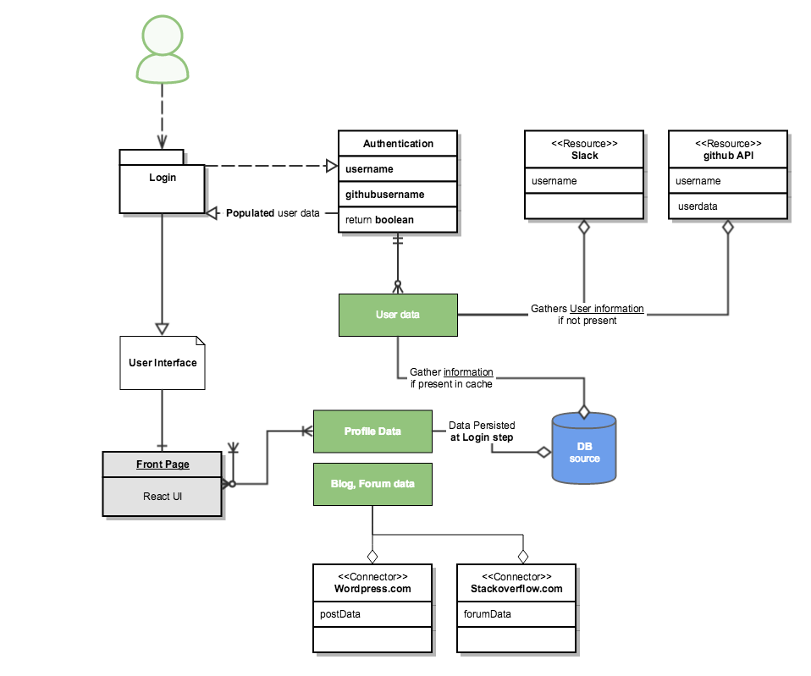

Slide 10
What was the hardest?
Understanding Arrow
How it works
Arrow Models
WordPress API authentication
Stack Exchange API filter
Connecting Slackbot with GitHub

Slide 11
2017 is coming…what features to expect?
Full CRUD functionality for all connectors
Testing all functionality and deploy process
Smart search for Front End
Introducing GitHub module to main app
ArrowDB
Notes:
Full CRUD
Testing all functionality
Deploy
Seacrh by tag…
Github module
ArrowDB – ruby апп който се свързва към монго.

Slide 12
THANK YOU!

